Slide 1
Cd-Bi phase diagram simulation with matlab®
Mohammad Hossein Abbasi student .No: 810799156
Soroush Nekoei student .No: 810799175

Slide 2
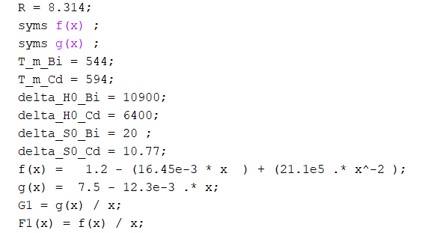
Assumptions:
* Being an ideal solution
Ideal gas constant (R)
Cd & Bi standard Gibbs energy
Cd & Bi Melting temperature
Cd & Bi standard enthalpy
Cd & Bi heat capacity equations

Slide 3
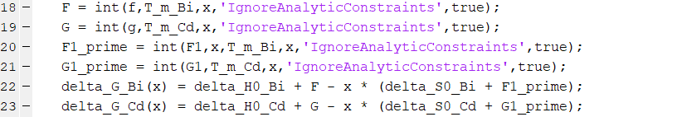
STEP 1:
Solving equations corresponding to Cd & Bi standard Gibbs energy ( equilibrium situation between liquid & solid phases )
Writing equations for enthalpy and entropy calculation
Writing equation for standard Gibbs energy calculation

Slide 4
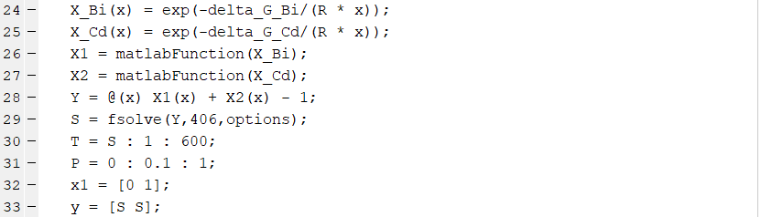
Step 2:
Solving equations with respect to chemical potential of pure substances and solution are both equal( standard phase for pure substance is solid due to melting temperature)
Since we’ve assumed our solution is ideal , derived equation has logarithmic changes with respect to composition
Solving equations derived from preceding procedure to obtain eutectic temperature value

Slide 5
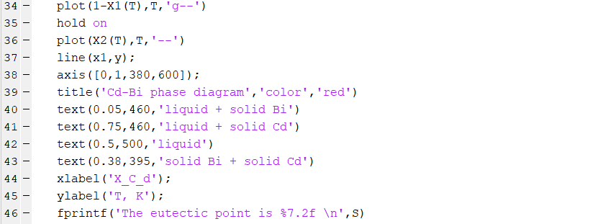
Step 3:
Plotting diagrams corresponding to derived equations and data which includes :
Liquidus line equation
Solidus line equation
Eutectic composition & temperature
Temperature limitation due to melting and transitions occurrence

Slide 6
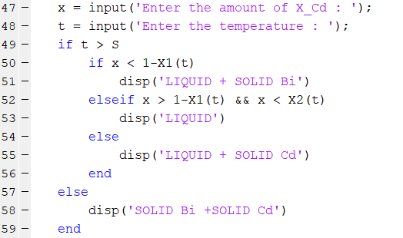
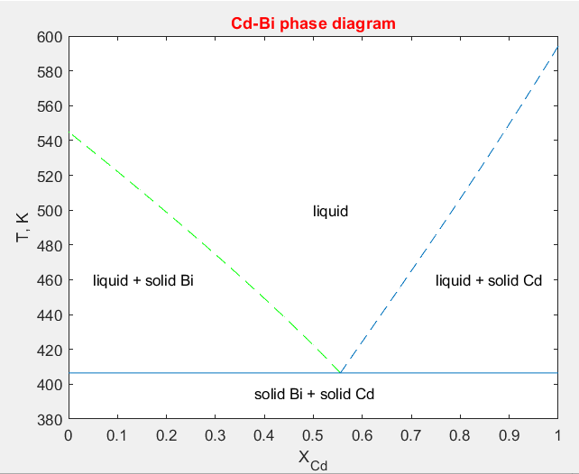
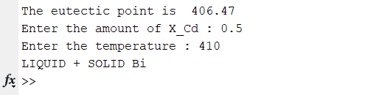
Results:
Cd-Bi phase diagram
*One of the options our simulation have is navigating stable phase situation with respect to given composition and temperature

Slide 7
The end

